Slide 1
Ignite 2017 recap
Firstname Lastname
Get the latest version of this presentation from
http://bit.ly/Ignite2017Recap

Slide 2



Firstname Lastname Microsoft MVP Title | Company
@Twitter
firstname.lastname@company.com

Slide 3

Ignite 2017
What is it, and why should I care?

Slide 4
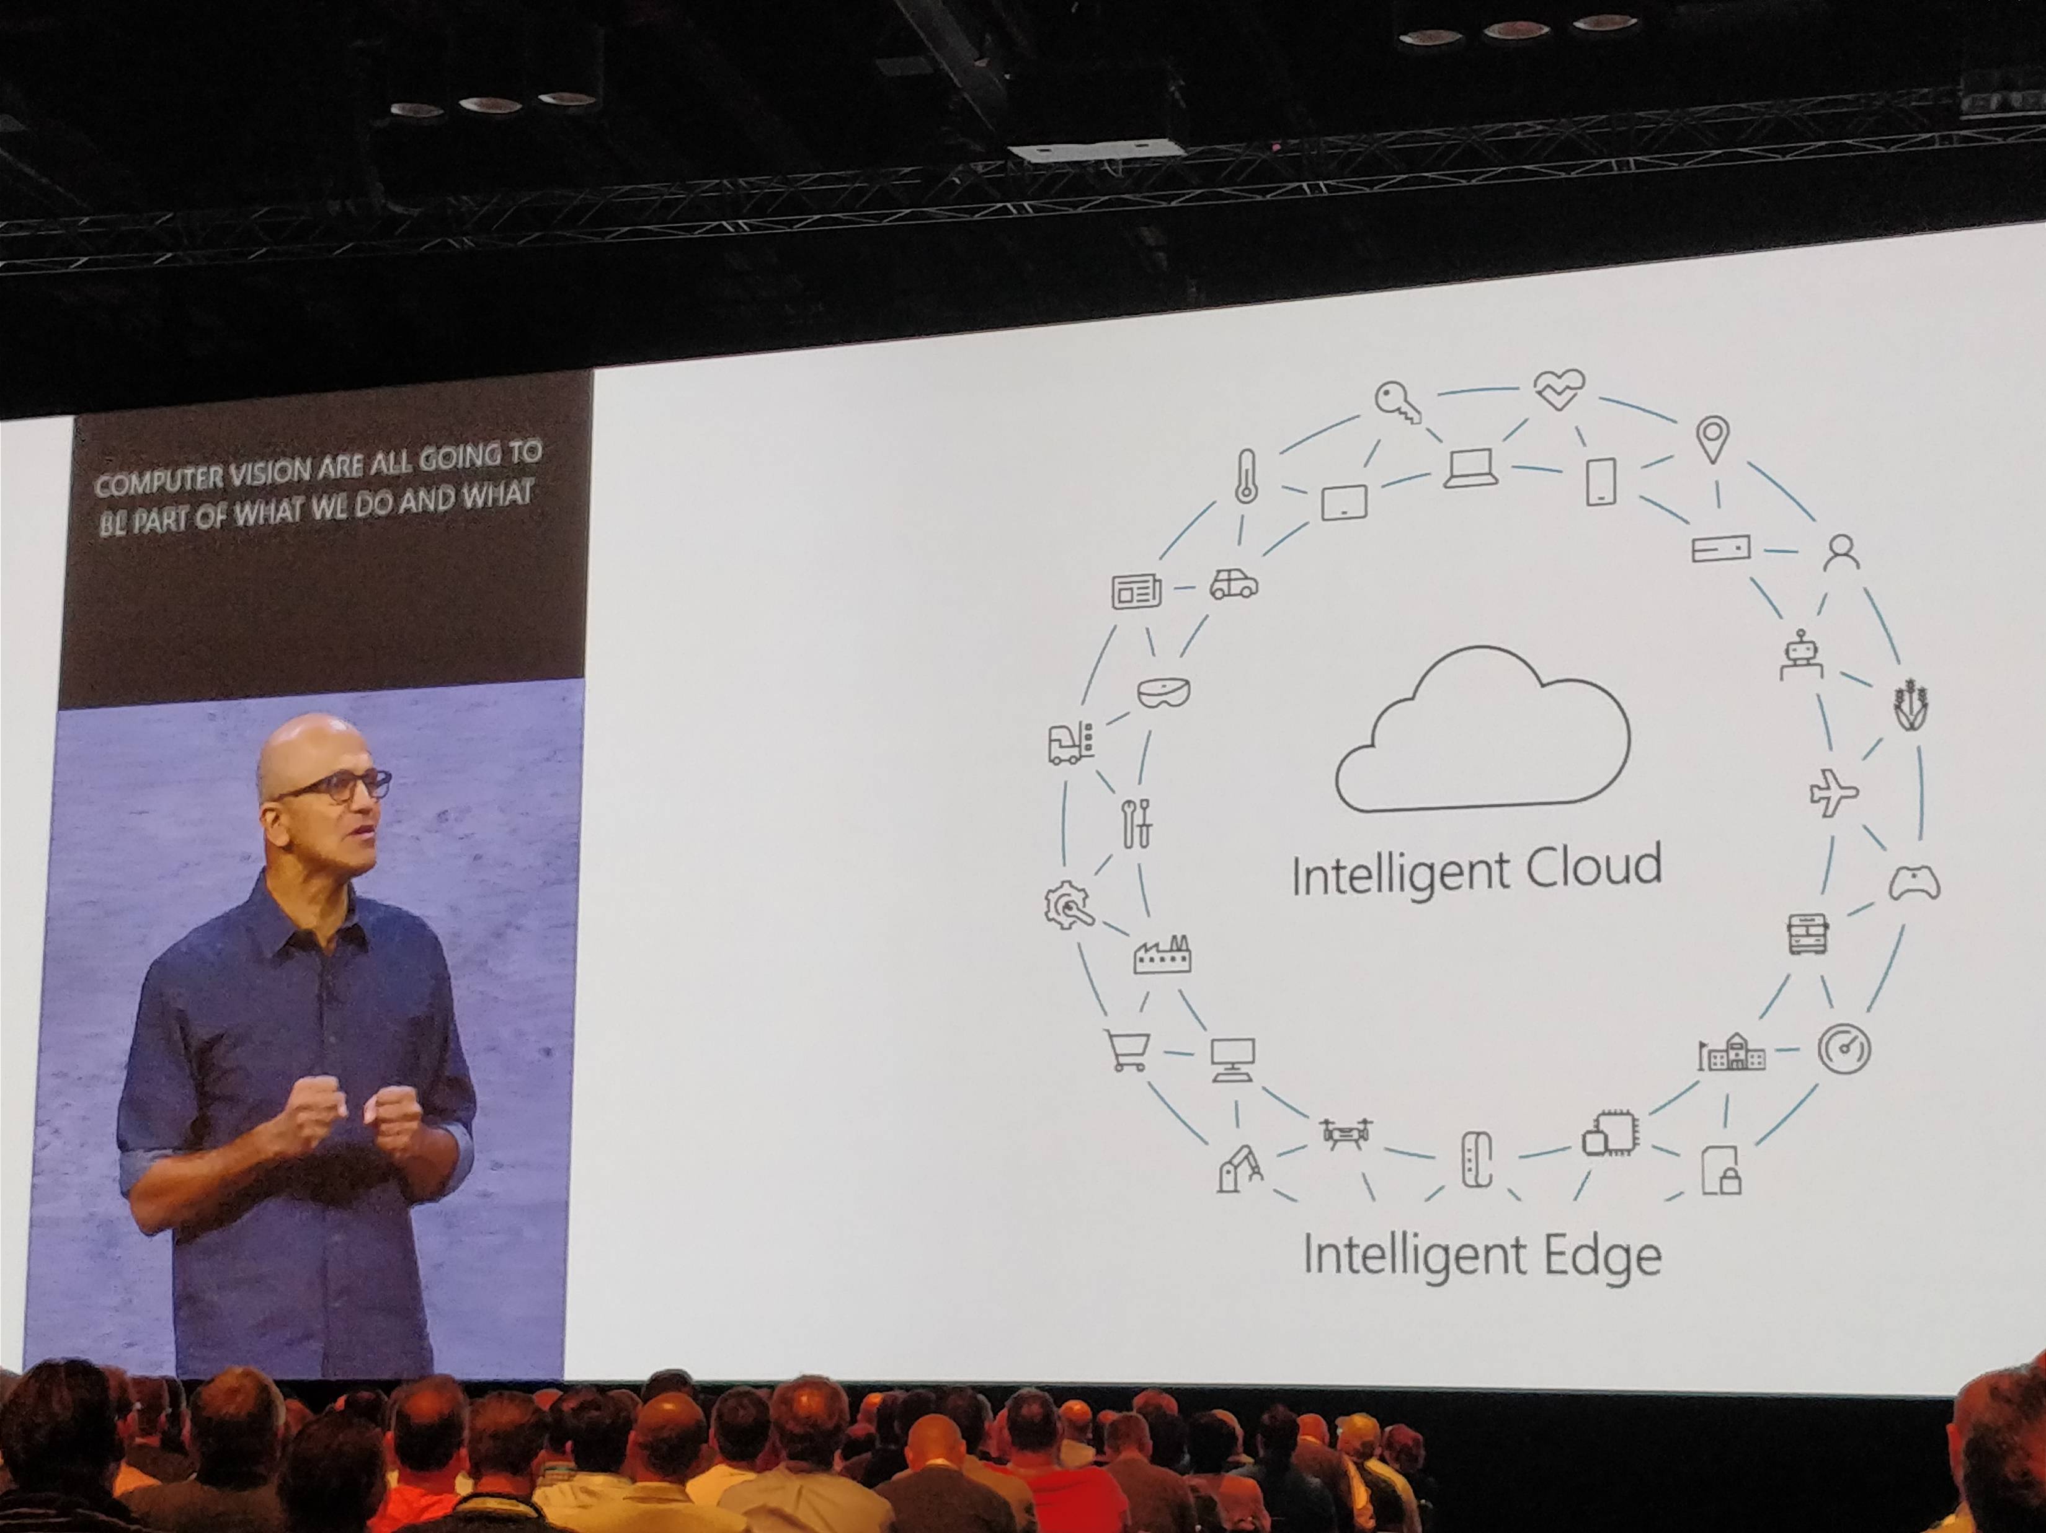
Largest Microsoft event of the year
Held in Orlando in late September
5 days, over 900 sessions representing all major Microsoft products and services
4 keynotes
Main keynote (Satya Nadella)
Modern Workplace (Kirk Koenigsbauer)
Business Applications (James Phillips)
The Enterprise Cloud (Scott Guthrie)
Over 24000 attendees
Session recordings and PowerPoints available through MyIgnite

Slide 5
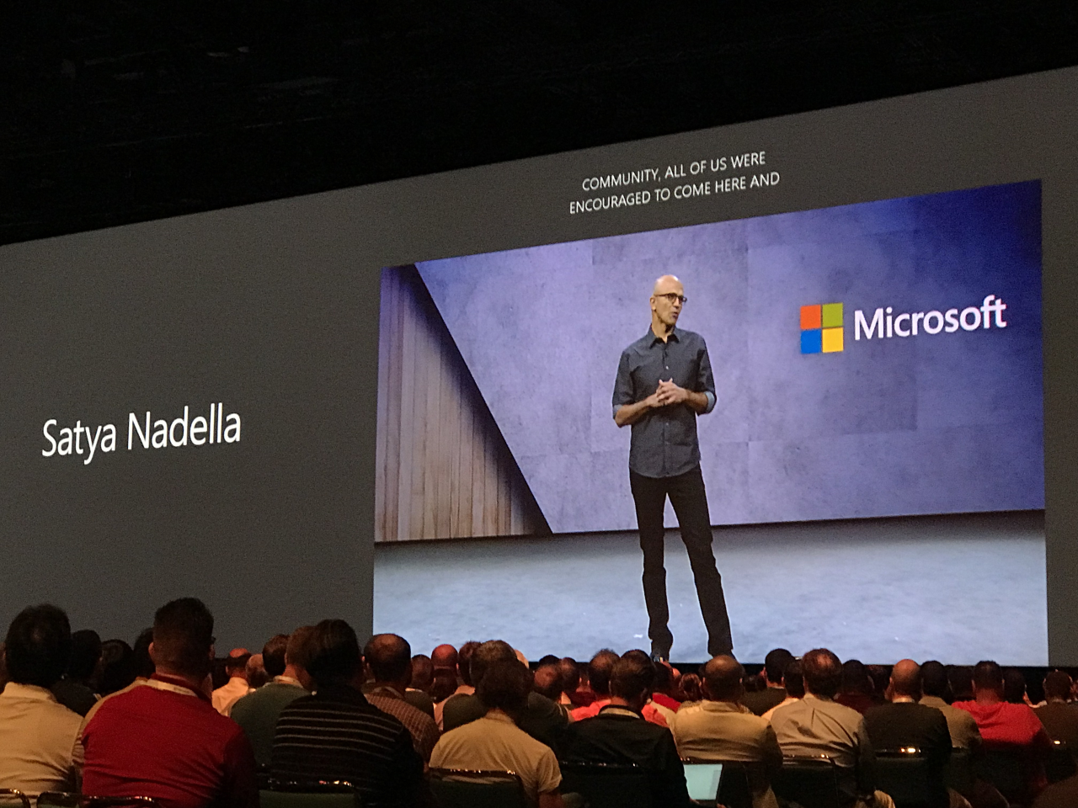
Windows and IT Pro

Slide 6

Co-management for Windows 10 with ConfigMgr and Intune
Transitioning management of settings to Intune
Co-management: VPN profiles, OS updates and conditional access checks can be transitioned from System Center Configuration Manager to Intune
Expect more capabilities in the future
Supports Windows 10
ConfigMgr can be used for managing legacy and classic, Intune for modern workloads (e.g. conditional access)
Requires Windows 10 Fall Creators Update and ConfigMgr Technical Preview Branch release (1709), coming later this year

Slide 7

GDPR compliance
Windows 10 & Windows Server 2016 white papers
Two new white papers announced, one for Windows 10 and one for Windows Server 2016 administrators
Windows 10 version
https://docs.microsoft.com/en-us/windows/configuration/gdpr-win10-whitepaper
Windows Server 2016 version
https://docs.microsoft.com/en-us/windows-server/security/gdpr/gdpr-winserver-whitepaper

Slide 8

Windows Server management
Project ”Honolulu”
Web-based management for Windows Server
Available in technical preview
https://www.microsoft.com/en-us/evalcenter/evaluate-windows-server-honolulu
Supports Windows Server 2017, 1709, Windows 10 – but not older server versions
Can be used to manage Hyper-V clusters also
Project “Honolulu” overview
https://blogs.technet.microsoft.com/windowsserver/2017/09/22/project-honolulu-technical-preview-is-now-available-for-download/
Deploy guidance
https://docs.microsoft.com/en-us/windows-server/manage/honolulu/deployment-guide

Slide 9
Windows Server 1709
Semi-Annual Channel releases
1709 – September 2017
Future releases every 6 months
Applies also to System Center and Server Core
Available in Azure in early October
Available from VLSC and MSDN in mid-October
Semi-Annual Channels explained
https://blogs.technet.microsoft.com/hybridcloud/2017/06/15/delivering-continuous-innovation-with-windows-server/

Slide 10



2019 wave of servers announced
New server releases in 2018
Exchange Server 2019 release preview in mid-2018, final release end of 2018
TAP program: https://aka.ms/ex2019tap
SharePoint Server 2019 release preview in mid-2018, final release H2/2018
No TAP yet
Skype for Business 2019 release preview also in mid-2018, final release end of 2018
No TAP yet, but keep an eye on https://www.skypepreview.com/

Slide 11

SQL Server 2017 for Windows, Linux & Docker
Generally available since October 2, 2017
SQL Server 2017 (RTM) images for Linux and Windows available on Azure Marketplace
Supports Windows, Red Hat Enterprise Linux, SUSE Enterprise and Ubuntu
Additional licensing, pricing and overview decks
https://azure.microsoft.com/en-us/services/virtual-machines/sql-server/
SQL Server 2017 on Azure VMs (Linux)
https://docs.microsoft.com/en-us/azure/virtual-machines/linux/sql/sql-server-linux-virtual-machines-overview
SQL Server 2017 on Azure VMs (Windows)
https://docs.microsoft.com/en-us/azure/virtual-machines/windows/sql/virtual-machines-windows-sql-server-iaas-overview
Notes:
Announcement: http://bit.ly/sql2017vm

Slide 12
New Windows 10 S devices
Cheaper ultraslims for Firstline workers
Four new Windows 10 S devices
HP Stream 14 Pro
Acer Aspire 1
https://www.acer.com/ac/en/US/content/series/aspire1
Acer Swift 1
https://www.acer.com/ac/en/GB/content/series/swift1
Lenovo V330
Priced between $275 and $349, and aimed for modern Firstline workers
Azure AD join
Intune-based management
Availability in late 2017

Slide 13
Get all Ignite 2017 recap presentations
http://bit.ly/Ignite2017Recap

